Slide 1
Social Media for Nonprofits
Lakewood Resource & Referral Center
212 2nd Street
Lakewood, NJ 08701

Slide 2
Do not settle.

Slide 3
Make a difference.

Slide 4
Respect the 80/20 rule.

Slide 5
What Social media is a collection of web tools that help you connect with others. Who You: Driven by your mission. Your Constituents: connected because you’re joining them in their neighborhood, and they like you. The World: looking for your movement, your content or the issues that intersect them. When Consistently, regularly. Where Wherever your constituents are; most likely your Blog, Email, and Facebook. Why Most important question. How As an integral part of your business process, driven by your mission.

Slide 6
WHO

Slide 7
You
Staff
Relationships are your job.
Security, succession.
Engaged
Link with your goals – who are the appropriate staff members to be involved?
Don’t create a single point of failure.

Slide 8
Your Constituents
They like you.
You’re joining them in their neighborhood.
You’re strengthening a relationship.
You can’t control what they say.

Slide 9
The World
Google. Bing.
Looking for your movement.
Looking for your content.
Looking for issues that intersect them.

Slide 10
WHAT

Slide 11
Social media is a set of digital tools that helps you tell stories and connect with others.

Slide 12
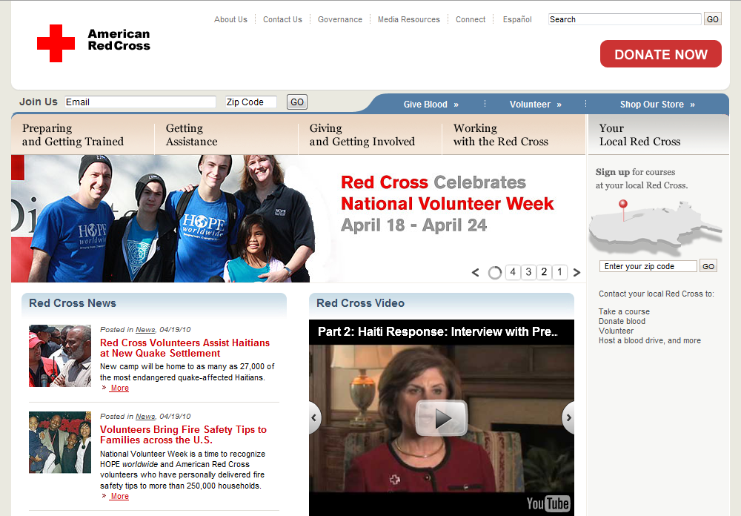
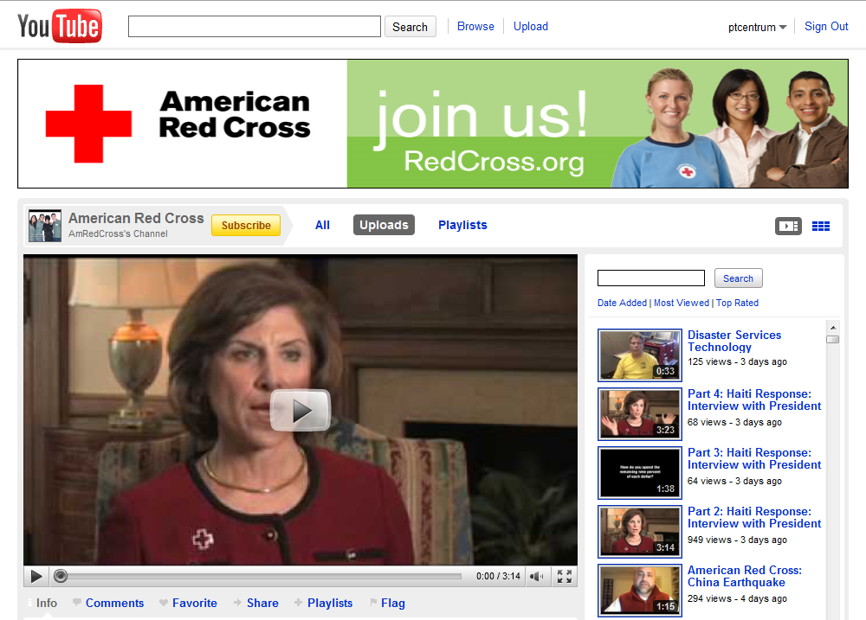
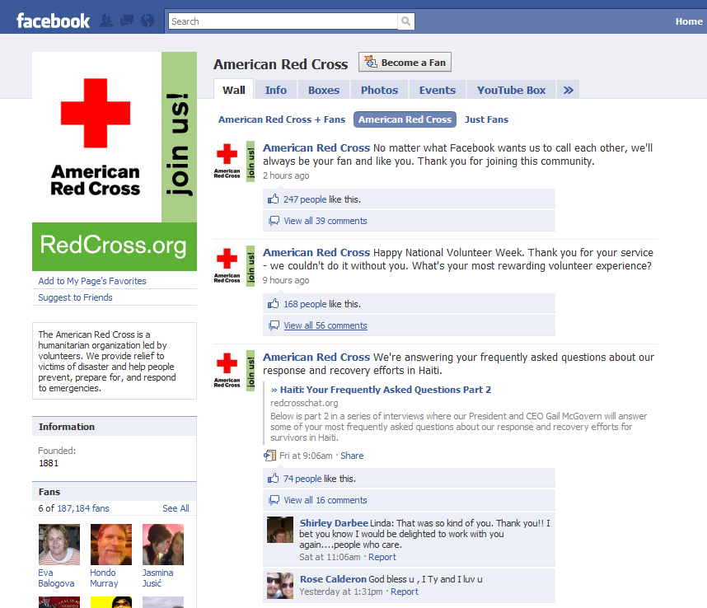
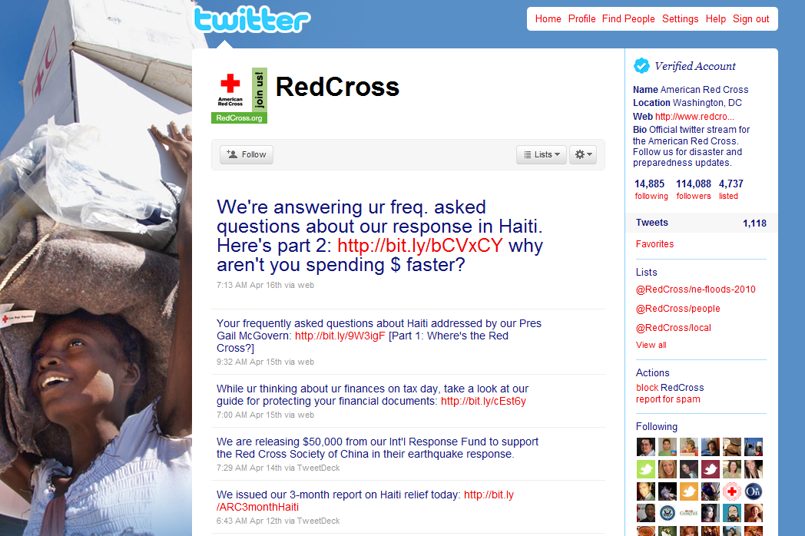
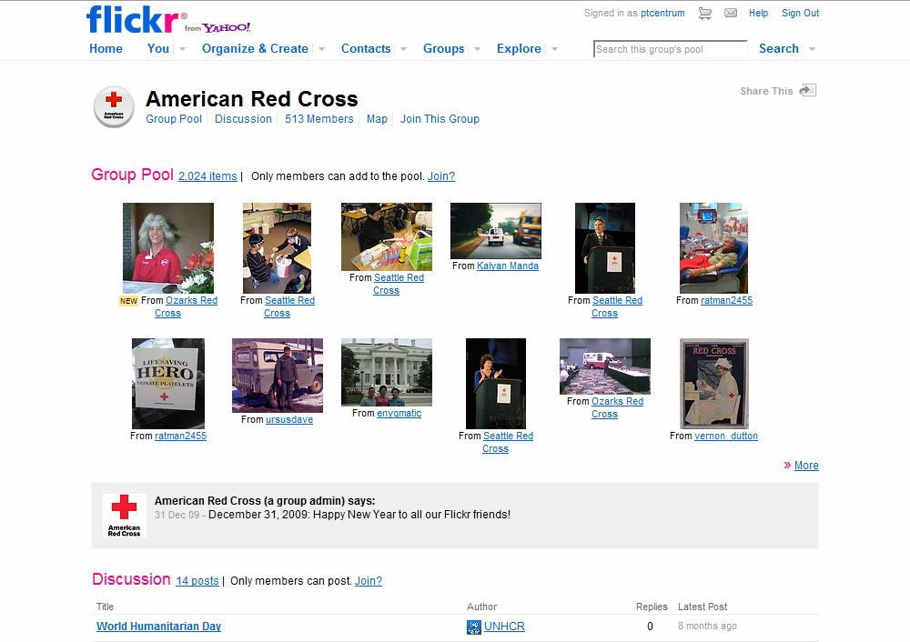

Slide 13
WHY

Slide 14
The most important question.

Slide 15
Just because you can, doesn’t mean that you should.

Slide 16
Your Plan
What is your plan?
What are your short-term goals?
What are your long-term goals?
How will you define success?

Slide 17
Are You Prepared?
Staff
Technology
Commitment

Slide 18
WHERE

Slide 19
Where your constituents are
Facebook has 400 million users.
Facebook users spend 55 minutes/day.
YouTube users watches 83 clips/month.
Growth is accelerating.

Slide 20
Where you get the best ROI
Return On Investment limits you.
What if you want to listen?
What if you want to tell stories?
What if you want to broadcast?
What if you want receive?
What if you want to drive action?
What if you want to optimize SEO?

Slide 21
HOW

Slide 22
This is your business
Every day, you build relationships.
Make social media integral to your work.

Slide 23
Guide Empower Monitor
Create and use social media guidelines.
Empower your staff to participate.
Monitor – gently – their participation.

Slide 24
Create accounts responsibly
Use dedicated signup-accounts.
Plan ahead for succession.
Build in redundancy.

Slide 25
Understand the ecosystems
Facebook great for community & dialogue.
Twitter good for driving traffic.
Email good for making the sale.
YouTube good for confirming passion.
Find your voice.

Slide 26
Your Website is Your Hub
WEBSITE/BLOG
Your Brand
Your Narrative
Your Events
Your Home

Slide 27
Now Add Spokes
Facebook
Twitter
WEBSITE
Media
Produce content.
Find content.
Add value.
Be goal and mission sensitive.
YouTube Flickr
(infrastructure)
Special Event
Email

Slide 28
Content is King
The. Critical. Element.
Narratives enable relationships.
Everything you do/read/view is a story.
Use all media – words, pictures, sounds…
Let the web work for you.

Slide 29
Content Toolkit
Digital point-& shoot camera ($100-200).
High-def portable video camera ($150).
…and BE THERE.
Staff, volunteers, participants.

Slide 30
Follower Numbers Aren’t Important
Remember the 80/20 rule.
A larger network is generally better.
A targeted network is best.
Be mission-driven and culturally-sensitive.

Slide 31
RED CROSS

Slide 32
What we like about the Red Cross
Clear information and calls to action.
Good storytelling.
Adding value while confirming passion.
Cross-purposing content sensitively.

Slide 33
WAYS OF BEING

Slide 34
Be a Magazine
Plan an “editorial calendar.”
Align with development calendar.
Align with programmatic calendar.
Hub = The Mag
Spokes = Departments

Slide 35
Be a Connector
Write/record your own pieces.
Use Facebook to generate feedback.
Use Twitter & FB to drive web traffic.
Use email to drive action.
Use YouTube/Flickr to document the experience.

Slide 36
Be a Community
Use Echo or Facebook Connect to make your own site interactive.
Make the focus of your efforts the collection and sharing of constituent stories.
Use YouTube/Flickr as pool feeds.

Slide 37
Be true.

Slide 38
Resources
Beth Kanter – beth.typepad.com
John Jantsch – ducttapemarketing.com
AMEX Open Forum – openforum.com
mashable.com
socialmediaexaminer.com

Slide 39
Thank You
Q&A
Keven Elliff

